Slide 1
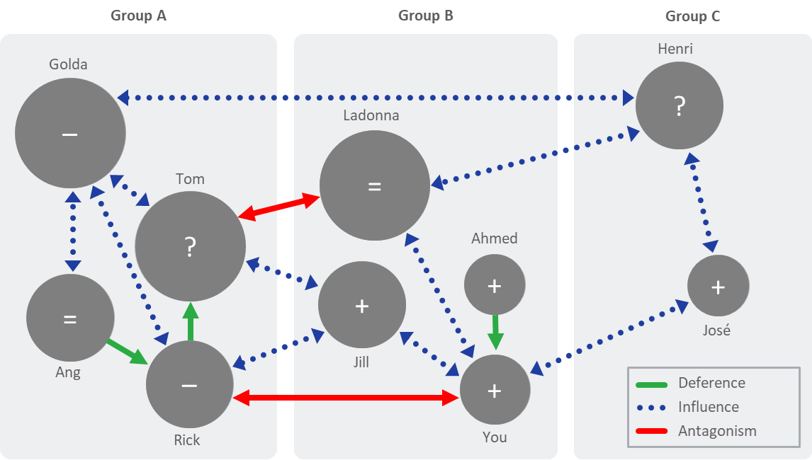
Stakeholder and Influence Mapping Tool
01-02
Sample Stakeholder and Influence Map

Slide 2
DEFERENCE
INFLUENCE
ANTAGONISM
Party A will almost certainly
  Do what Party B does, or
  Do what Party B advises, asks, or directs Party A to do
Sources of “deference”
  Hierarchy, mentorship, sponsorship
  Political power, seniority
  Personal respect, admiration
  Expertise, status, reputation, etc.
Watch for “patterns of deference” among the mapped players
(i.e., who defers to whom?)
Represented as a green line on the stakeholder mapping diagram
Party A is likely to
  Follow Party B’s lead, or
  Do what Party B advises, asks, or directs Party A to do
Sources of “influence”
  Trust of judgment, best intentions
  Successful track record
  Shared interests, common outlook, etc.
Watch for “patterns of influence” among the mapped players
(i.e., who can help secure support from others?)
Represented as a blue dotted line on the stakeholder mapping diagram
Party A is unlikely to
  Follow Party B’s lead, or
  Do what Party B advises, asks, or directs Party A to do
  Sources of “antagonism”
  Political opposition, conflicting interests
  Mistrust of judgment, intentions
  Unsuccessful track record
  Watch for “patterns of antagonism” among the mapped players
  (i.e., whose support would preclude agreement with others?)
  Represented as a red line on the stakeholder mapping diagram

Slide 3
Stakeholder and Influence Mapping Tool (cont.)
02
Copy and Paste elements below to create your Influence Map
Arrows
Deference
Influence
Antagonism
Circles
Name
Name
Name

Slide 4
Stakeholder and Influence Mapping Tool (cont.)
02
Copy and Paste elements below to create your Influence Map
Arrows
Deference
Influence
Antagonism
Circles
Name
Name
Name

Slide 5
Stakeholder and Influence Mapping Tool (cont.)
03-04

